Slide 1
WT PROJECT
BY
ROSHNAV K (PES2UG21CS438)
RUTVIJ S (PES2UG21CS439)
S RAMANUJAN (PES2UG21CS441)

Slide 2
INTRODUCTION
Welcome to TURF Sports Arena.
A place where you can lose yourself for an hour or two and escape life's pressures. With benefits that extend beyond health, check us out and discover how getting a head for fitness can help you unwind and re-energise.
Sports are a crucial part of a student’s growth and development. They help in the development of mental health and physical fitness of the body. Through participation in sports and games, a student gains various skills, experience and confidence that are helpful for developing their personality.

Slide 3
CONCEPTS USED
CSS :
CSS stands for Cascading Style Sheets. It is a style sheet language which is used to describe the look and formatting of a document written in markup language.
It provides an additional feature to HTML.
It is generally used with HTML to change the style of web pages and user interfaces. It can also be used with any kind of XML documents including plain XML, SVG and XUL.
HTML :
HTML, or Hypertext Markup Language, is a markup language for the web that defines the structure of web pages.
It is one of the most basic building blocks of every website.

Slide 4
CONCEPTS USED
ReactJS :
React.js, more commonly known as React, is a free, open-source JavaScript library.
It works best to build user interfaces by combining sections of code (components) into full websites.
It is declarative and component based.
NodeJS :
Node.js is a platform built on Chrome's JavaScript runtime for easily building fast and scalable network applications.
Node.js uses an event-driven, non-blocking I/O model that makes it lightweight and efficient, perfect for data intensive real-time applications that run across distributed devices.

Slide 5
CONCEPTS USED
MongoDB :
MongoDB is an open source NoSQL database management program.
NoSQL is used as an alternative to traditional relational databases.
NoSQL databases are quite useful for working with large sets of distributed data.
MongoDB is a tool that can manage document-oriented information, store or retrieve information.

Slide 6
ROLES OF CONCEPTS USED
We use REACT,NODE,MONGODB to
further make our webpage more user
friendly(make the buttons and cards
useable) and sophisticated
to fulfill the needs of every
user.
• We use HTML and CSS for
creating a basic webpage
with adequate design and a
backbone for our webpage.
• To make cards and
workspaces along with
options whose functionality
will be taken care of in the
upcoming steps.

Slide 7
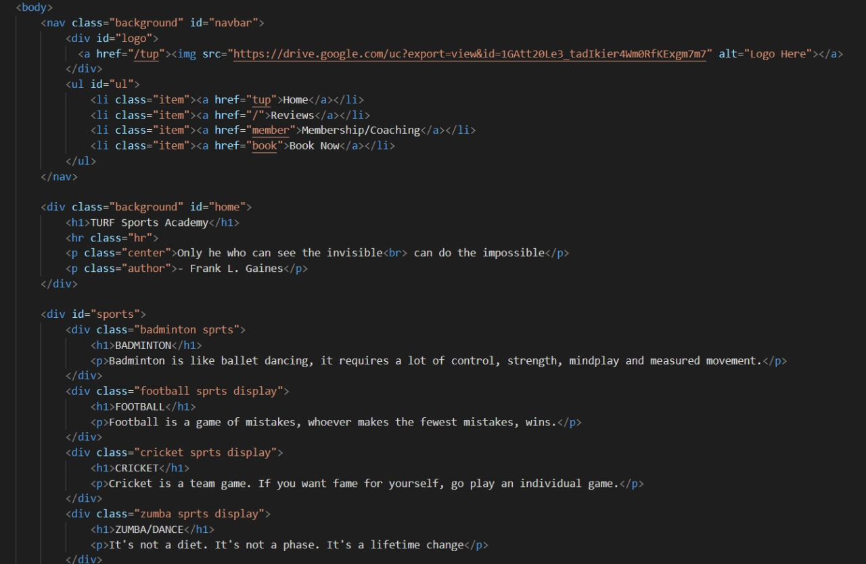
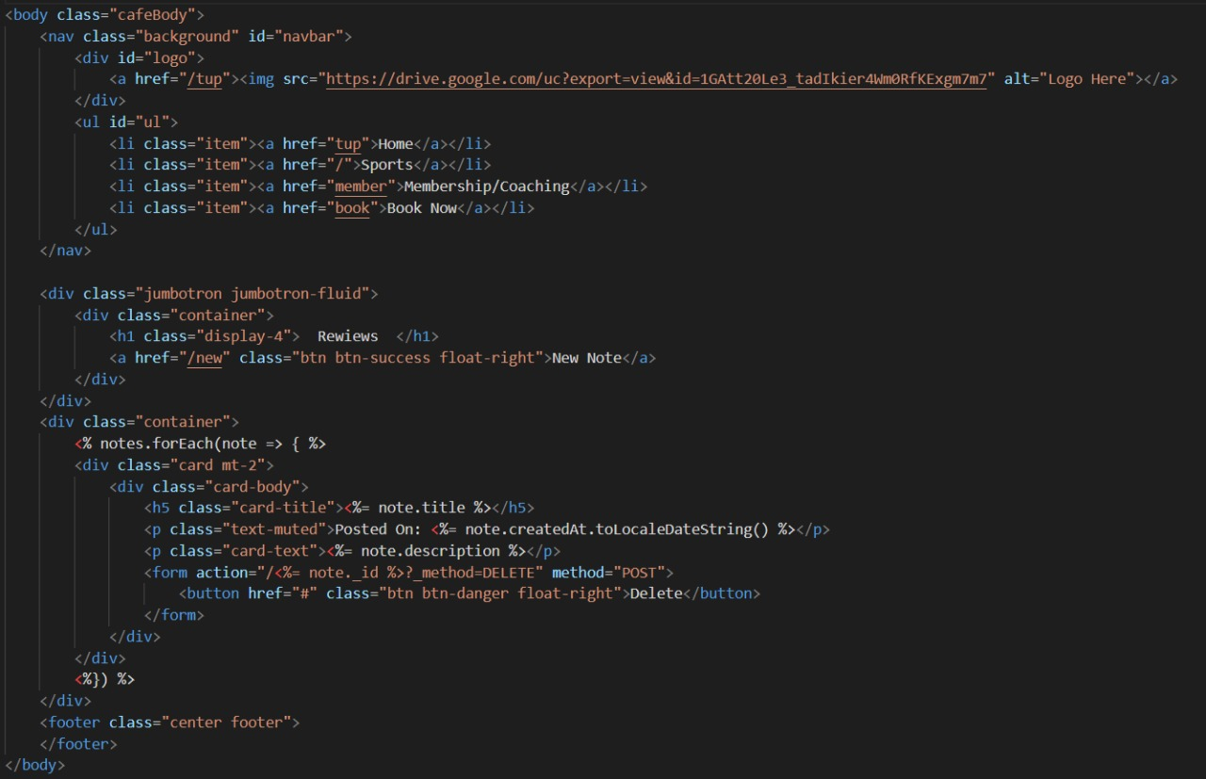
CODE SNIPPETS

Slide 8
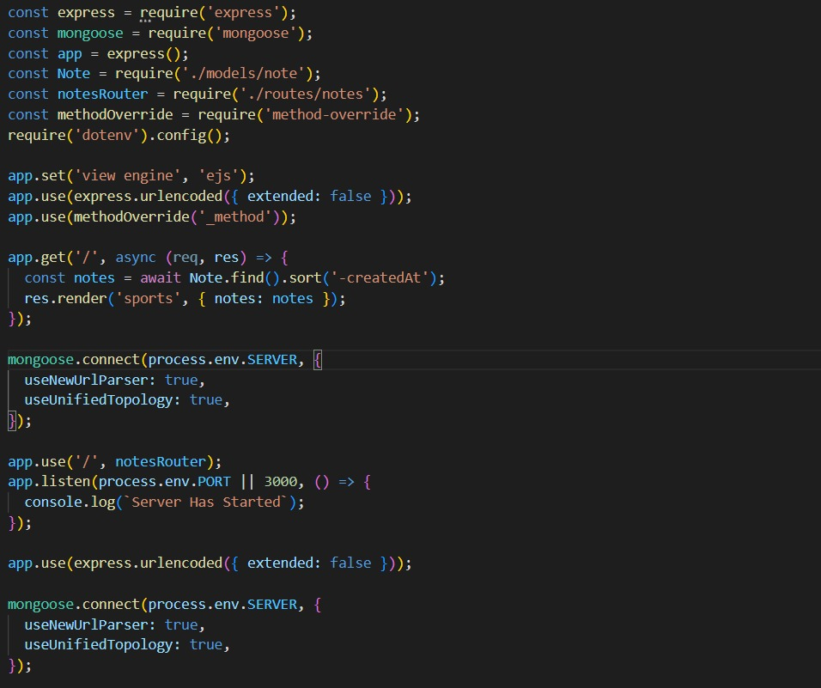
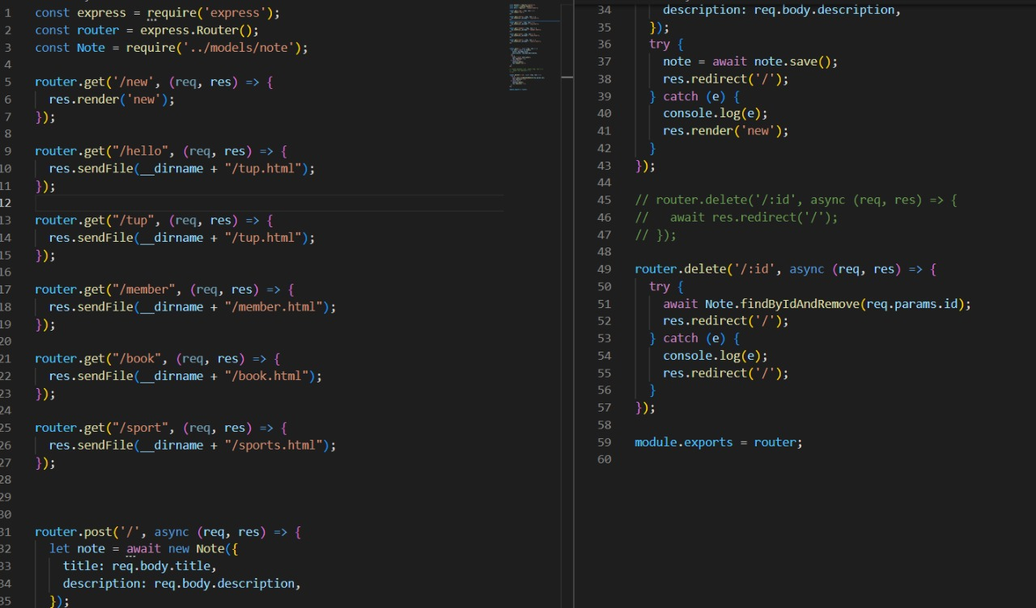
CODE SNIPPETS(cont...)

Slide 9

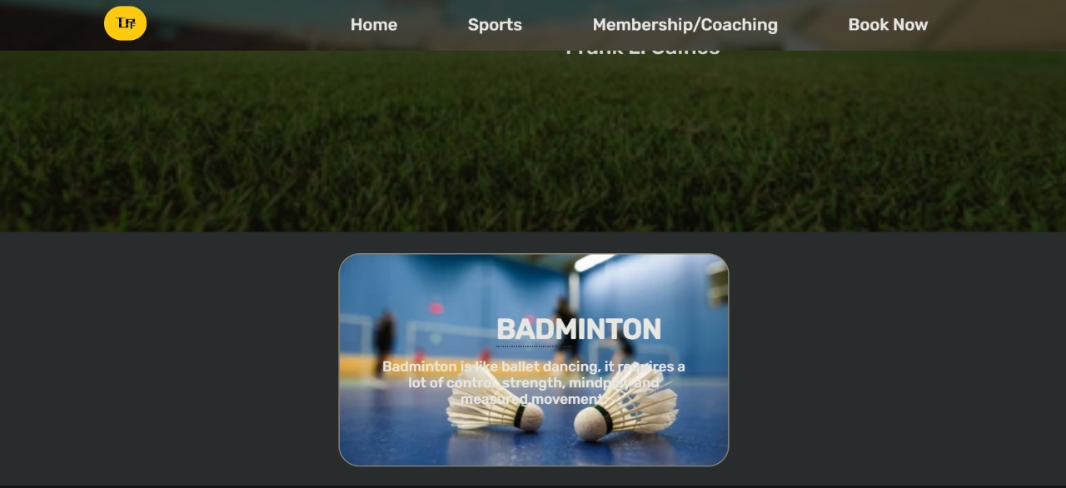
OUTPUT SNIPPETS

Slide 10
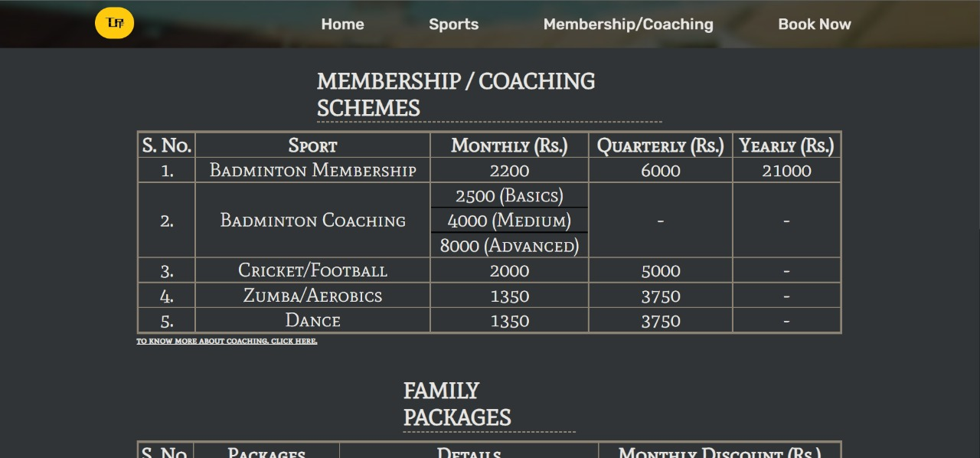
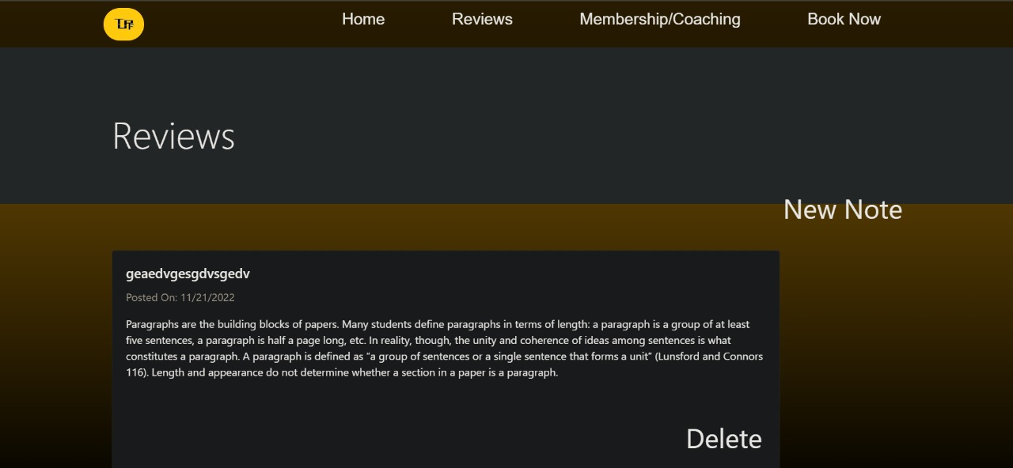
OUTPUT SNIPPETS(cont...)

Slide 11
Thank you

